Slide 1


QUARTERLY BUSINESS REVIEW
GGMI (LATAM) — Paid Media
Q3 FY2026 Business Review · June 2026 Performance
Bing Ads · Meta · Azerion · Quantcast
Reporting period: June 1–30, 2026 | Currency: USD | Prepared by Berelvant · 07.16.2026

Slide 2
FOREX.com | GGMI (LATAM) · June 2026
SUMMARY · BLENDED VIEW (ORGANIC + PAID)
Paid-driven applications grew through Q3 while the blended base softened.
• June submitted applications came in at 684, down 7% MoM; the H1 peak was February (1,036).
• New approved rose 7% to 209 and the approval rate recovered to 31%, the best since February.
• New funded dipped 11% to 32 and the fund rate to 15%. The application-to-funding step is the funnel constraint.
• New traded closed at 29; trading volume held at $1.1B.
• Working media reached $120,393 in June (+53% MoM), the biggest month of 2026, while paid-driven applications grew every month of Q3.
GGMI — blended | Jan | Feb | Mar | Apr | May | Jun | MoM
Working Media Spend | $1,717 | $20,578 | $42,424 | $46,294 | $78,790 | $120,393 | +53%
Submitted Applications | 1,029 | 1,036 | 900 | 751 | 732 | 684 | -7%
Approved Clients | 288 | 337 | 261 | 202 | 195 | 209 | +7%
Approval Rate | 28% | 33% | 29% | 27% | 27% | 31% | +4pp
New Funded Clients | 66 | 59 | 63 | 38 | 36 | 32 | -11%
Fund Rate | 23% | 18% | 24% | 19% | 18% | 15% | -3pp
Cost per Funded Client | $26 | $349 | $673 | $1,218 | $2,189 | $3,762 | +72%
New Traded Clients | 56 | 52 | 57 | 35 | 36 | 29 | -19%
Cost per Traded Client | $31 | $396 | $744 | $1,323 | $2,189 | $4,151 | +90%
Trading Volume | $5.1B | $2.5B | $2.3B | $2.1B | $1.1B | $1.1B | flat
Funnel metrics are blended organic + paid. Working media per the budget tracker. MoM = June vs May. January cost figures reflect a near-zero media base ($1,717); the scaled-media baseline starts in March.
GGMI (LATAM) | June 2026 Performance Review | Berelvant
2 / 22

Slide 3
FOREX.com | GGMI (LATAM) · June 2026
Q3 FY2026 IN REVIEW · SPEND
Spend rose from $46K in April to $120K in June.
Channel | Apr | May | Jun | Q3
Bing Ads | $15,289 | $15,972 | $25,659 | $56,920
Meta | $5,224 | $6,626 | $25,924 | $37,774
Quantcast | $15,005 | $26,890 | $33,784 | $75,678
Azerion | $10,777 | $29,302 | $35,026 | $75,105
Total | $46,294 | $78,790 | $120,393 | $245,477
READ
Q3 closed at $245,477 in working media, approximately 24% of the FY2026 budget.
The mix rebalanced as the program scaled. April leaned on search and display; June is a balanced four-channel program with no channel above 29% of spend.
Every channel grew while holding or improving its efficiency where we can measure it, which is what earns the next stage of scale.
Month-over-month growth: +70% into May, +53% into June. June ran at 2.6x the April level.
GGMI (LATAM) | June 2026 Performance Review | Berelvant
3 / 22

Slide 4
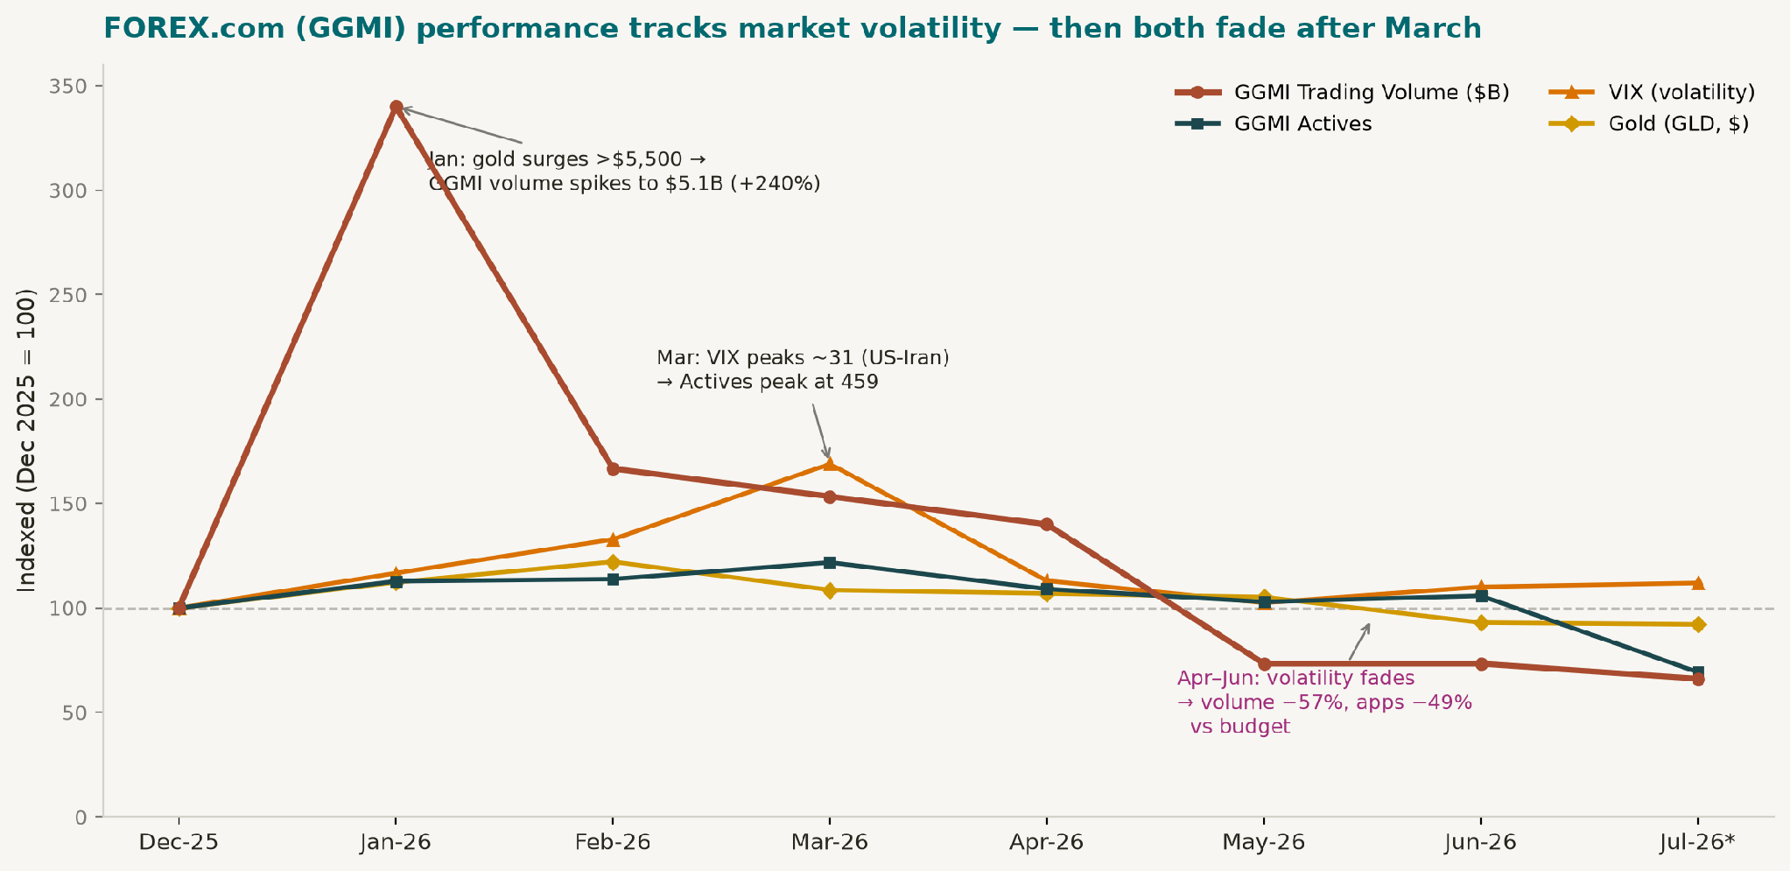
FOREX.com (GGMI) performance tracks market volatility
Dec 2025 – Jul 2026 · Budget vs Actual (Reforecast GGMI) · all series indexed to Dec 2025 = 100
0.91
Live Apps vs Gold (GLD)
r =
very strong
0.94
Actives vs VIX (Dec–Jun)
r =
very strong
0.62
Trading Volume vs Gold
r =
moderate–strong
0.67
New Funded vs VIX
r =
moderate–strong
Key insight: GGMI's acquisition funnel and active base moved closely with market volatility this period: applications tracked gold (r=0.91) and actives tracked VIX (r=0.94). The Apr–Jun miss vs budget is largely the volatility tailwind reversing more than media performance. January's $5.1B volume spike was gold-driven; as gold and VIX faded, volume fell 78% from the January peak to $1.1B.
Source: GGMI Budget vs Actual (Reforecast) dashboard · CBOE VIX, SPDR Gold Shares (GLD) OHLC market data

Slide 5
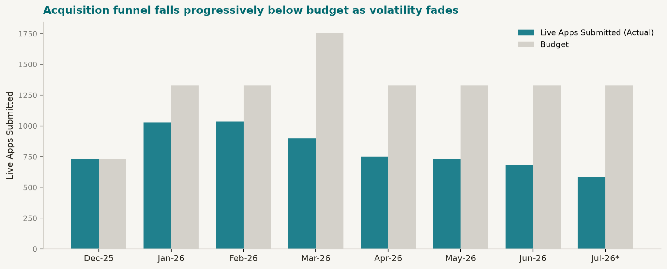
Acquisition funnel falls below budget as volatility fades
Live Apps Submitted: Actual vs Budget
What it means for the strategy
Volatility = the acquisition dial.
Time spend to VIX > 20–25 spikes; in calm periods (VIX ~17 now) shift budget to activation & retention.
Gold is the strongest correlate of applications.
Apps track gold at r=0.91. Lead Mexico creative with gold market education and volatility context.
July stays soft.
Low-vol regime → funnel remains under budget unless Fed/CPI/Sept hike reignites VIX.
The real story: Downstream outcomes (traded, actives, volume) beat budget through March on the volatility wave (Jan volume +176% vs budget). Applications ran about 22% under budget even then, and the gap widened as gold/VIX normalized — July apps (forecast) at 586 vs 1,328 budget (−56%). Re-engage aggressive acquisition only when VIX pushes back above ~20–25.
Media plan: intent + reactivation.
Bing Ads search on gold/CFD keywords to capture gold-intent (r=0.91); programmatic display to reactivate Jan–Mar sign-ups during VIX>20 bursts.
Source: GGMI Budget vs Actual (Reforecast) dashboard · VIX/GLD OHLC market data

Slide 6
FOREX.com | GGMI (LATAM) · June 2026
Q3 FY2026 IN REVIEW · APPLICATIONS
92 submitted applications in June at $660 per submitted application.
Channel | Apr | May | Jun | Q3
Bing Ads | — | 33 | 50 | 83
Azerion | 19 | 37 | 42 | 98
Quantcast | 0 | 1 | 11 | 12
Meta | 1 | 0 | Held | 1
Submitted (Bing + Azerion) | 19 | 70 | 92 | 181
Cost / submitted app | $1,372 | $647 | $660 | $729
READ
June delivered about 5x the submitted-application volume of April on 2.6x the spend.
Cost per submitted application, Bing plus Azerion, fell from $1,372 in April to $660 in June and held there through a 53% spend increase, so the growth was bought at improving efficiency.
Search and programmatic carried the measured volume: 92 submitted applications in June at $660 each, 181 across Q3. Paid social contributed reach and site traffic while its conversion validation completes.
Search tracking went live in May; display and search lines count submitted applications, the reach line counts view-through, and paid-social conversions are under validation. The submitted total (92 in June) is Bing plus Azerion; Quantcast view-through and Meta are not summed into it.
GGMI (LATAM) | June 2026 Performance Review | Berelvant
6 / 22

Slide 7
FOREX.com | GGMI (LATAM) · June 2026
Q3 FY2026 IN REVIEW · BLENDED OUTCOMES VS PLAN
The gap to plan sits in the non-paid base.
Metric (organic + paid) | Q3 Actual | Q3 Budget | vs Plan
Live Apps Submitted | 2,167 | 3,984 | -46%
New Approved | 606 | 957 | -37%
New Funded | 106 | 240 | -56%
New Traded | 100 | 180 | -44%
Actives (monthly avg) | 399 | 485 | -18%
Trading Volume | $4.3B | $6.7B | -36%
READ
Blended submissions ran about 45% under plan and declined through the half-year (1,029 in January to 684 in June) while paid-driven applications grew every month of Q3. The shortfall sits in the non-paid base, where two forces overlap: the volatility tailwind that carried the early-year baseline reversed (previous slides), and the site's organic capture declined (next two slides).
The funded stage shows the second constraint: -56% to plan, the application-to-funded step the onboarding roadmap is built to fix.
Trading volume tracked the softer funnel at $4.3B against a $6.7B plan.
Source: Budget vs Actual dashboard (non-cohort reforecast), GGMI, organic and paid blended. July excluded (full-month forecast).
GGMI (LATAM) | June 2026 Performance Review | Berelvant
7 / 22

Slide 8
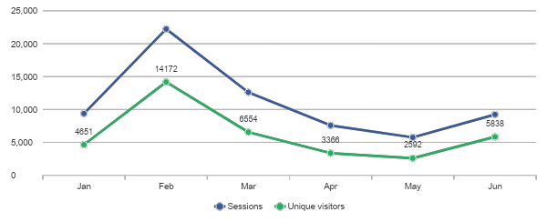
FOREX.com | GGMI (LATAM) · June 2026
SITE TRAFFIC · SIX-MONTH VIEW (GA4, MEXICO)
June sessions rose 61% on the media scale-up. Organic sat at its low.
WHAT IT MEANS
Media is doing its job. June proves it can move traffic on demand.
Unique visitors are up 26% January to June, the legitimate bright spot in the half-year.
The organic foundation needs its own workstream. Until it recovers, total site traffic will track media spend rather than compound on top of it.
THE HONEST READ
February was one paid flight, not organic growth; it ended in early March and is not a baseline. The March-May slide is organic search decline, confirmed in Search Console. June's rebound was bought: of the +3,485 sessions vs May, paid search added +2,601, paid social +537, display +274. Organic added +94.
GGMI (LATAM) | June 2026 Performance Review | Berelvant
8 / 22

Slide 9
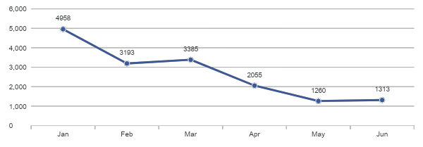
FOREX.com | GGMI (LATAM) · June 2026
ORGANIC SEARCH · THE STRUCTURAL ISSUE
Organic search fell 75% in six months. Media cannot buy it back.
Organic Search sessions · GA4, Mexico
WHAT IS DRIVING IT
Dated news and analysis content lost 87-99% of its clicks as it aged out with nothing replacing it, and mid-funnel commercial pages slid in rank while brand improved. The decline spans every country the Spanish site serves: a site-level content issue, confirmed independently in site analytics.
Search Console (Mexico) | January | June | Change
Organic clicks | 4,811 | 1,210 | -75%
Demo account page (position) | 12 | 23 | slid
Trading academy page (position) | 14 | 24 | slid
Homepage, brand (position) | — | 2.5 | improved
WHAT WE RECOMMEND
Track this as a known organic-risk workstream pending NextGen. When it starts, the plan is to restore the news and analysis publishing cadence, refresh the decayed assets, and run a mid-funnel rank-recovery plan (demo, academy, platform pages), measured on organic clicks and positions. Until it lands, paid media works harder each month just to hold total traffic flat.
GGMI (LATAM) | June 2026 Performance Review | Berelvant
9 / 22

Slide 10
FOREX.com | GGMI (LATAM) · June 2026
EXECUTIVE SUMMARY
$120K deployed in June. Search and display held their CPAs through the scale-up.
Channel | Spend | Impr | Clicks | Conv | CPA
Bing Ads | $25,659 | 466,582 | 21,480 | 50 | $513
Meta | $25,924 | 19.78M | 407,136 | Held* | —
Azerion | $35,026 | 7.68M | 9,910 | 42 | $834
Quantcast | $33,784 | 41.96M | 11,284 | 11 VT* | —
Total | $120,393 | 69.9M | 449,810 | — | —
HEADLINES
June was the biggest GGMI media month of 2026: $120,393 across four channels, up 53% from May. Search produced 50 submitted applications at a $513 CPA, up from 33 in May, and Azerion held efficiency with 42 applications through a 20% budget increase.
* Paid-social conversions are held pending on-site measurement validation. Programmatic view-through is directional only. Conversions use different events per channel and are never summed.
WHAT THE DATA SAYS
JUNE PRIORITY
Site traffic recovered with the spend: 9,236 Mexico sessions, up 61% from May, and 5,838 unique visitors, up 125%. The recovery is real but bought. Media drove the June gain while organic search sat at its low.
We are approximately 31% into the annual GGMI budget, so H2 has room to scale once the quality fixes land.
Confirm the now-applied Mexico-only search targeting in July delivery, audit paid-social placements before reinstating its conversion reporting, and open the SEO workstream for the organic decline.
GGMI (LATAM) | June 2026 Performance Review | Berelvant
10 / 22

Slide 11
FOREX.com | GGMI (LATAM) · June 2026
CONT' EXECUTIVE SUMMARY
Three findings shape the July plan.
WHAT IS STILL FORMING
WHAT WE RECOMMEND
The June traffic recovery was bought by media. Organic search has fallen 75% since January, confirmed independently in Search Console, for identifiable SEO reasons. No media budget fixes this, and it is why total site traffic feels flat while investment grows.
Meta scaled spend 291% with Facebook-native, feed-led delivery. Its conversion reporting stays on hold until on-site conversion measurement is validated.
Search geo, as reviewed together: $8,612 of June delivery served outside Mexico. Mexico-only targeting is now applied, and July delivery will show the correction.
Verify the corrected Mexico-only search targeting in July delivery; roughly $8.6K per month is redirected into Mexico.
Refine the paid-social audience to 25+ and validate on-site measurement before scaling it further; judge the channel on measured site sessions until then.
Track the SEO workstream for the Spanish site as a known organic risk, pending NextGen. It is the structural fix for traffic that tracks media spend instead of compounding on top of it.
Apply the 49-site programmatic blocklist and set a campaign-level viewability floor.
GGMI (LATAM) | June 2026 Performance Review | Berelvant
11 / 22

Slide 12
FOREX.com | GGMI (LATAM) · June 2026
BING ADS · PERFORMANCE
50 submitted applications at $513, up from 33 at $484 in May.
SPEND
IMPRESSIONS
CLICKS
AVG CPC
SUBMITTED APPS
CPA
$25,659
466,582
21,480
$1.19
50
$513
+61% MoM
3 campaigns
CTR 4.60%
May: $0.53
May: 33
May: $484
Campaigns
Campaign | Spend | Clicks | Apps | CPA
AO Generic (policy test) | $13,508 | 11,020 | 27 | $500
Brand + Generic | $8,154 | 7,559 | 9 | $906
Platform Intercept | $3,996 | 2,901 | 14 | $285
HIGHLIGHTS
Conversions rose 52% (33 to 50) while spend rose 61%, so the CPA moved only $484 to $513 through the scale-up.
The account expanded from 1 campaign to 3. Platform Intercept is the efficiency leader at a $285 CPA.
CPC rose $0.53 to $1.19 with the shift into the new campaign themes.
Geo delivery, as reviewed together: $8,612 of June delivery served outside Mexico, led by Spain, Venezuela, and the US. Mexico-only targeting (people in Mexico) is now in place, and July reports on the corrected setup.
GGMI (LATAM) | June 2026 Performance Review | Berelvant
12 / 22

Slide 13
FOREX.com | GGMI (LATAM) · June 2026
BING ADS · READ & RECOMMENDATIONS
Concentrate every search dollar in Mexico.
WHAT THE DATA SHOWS
WHAT WE RECOMMEND
Search remains the most efficient measured converter in the account, and it held that efficiency while scaling 61%.
June was the last month on the old geo setup, with $8,612 delivered outside Mexico. With Mexico-only targeting now in place, that spend concentrates in-market, which should improve effective Mexico CPA immediately.
The new campaign themes raised CPC ($0.53 to $1.19). Platform Intercept converts at $285, so the mix has room to rebalance toward what works.
Mexico presence-only targeting is applied; the July report will show the in-market correction, with roughly $8.6K per month redirected into Mexico.
Rebalance budget toward the proven converters, led by Platform Intercept at $285, while the newer themes prove out.
Link the search account in GA4 so July reporting attributes paid search fully (detail on the measurement slide).
GGMI (LATAM) | June 2026 Performance Review | Berelvant
13 / 22

Slide 14
FOREX.com | GGMI (LATAM) · June 2026
META · PERFORMANCE
Meta ran a traffic objective in June: 249,972 landing-page visits. Conversion measurement is the open item.
SPEND
IMPRESSIONS
LINK CLICKS
REACH
LP VIEWS
CONVERSIONS
$25,924
19.78M
407,136
6.3M
249,972
Held
+291% MoM
CPM $1.31
CTR 2.06%
freq 3.0
platform-reported
validation open
Meta program | Spend | Impressions | Link clicks
Prospecting / traffic | $25,345 | 19.34M | 397,406
Engagement (Followers) | $579 | 0.44M | 9,730
WHY CONVERSIONS ARE HELD
The platform reports 86 conversions for June. 67 of them come from one retargeting campaign with only 126 landing-page views, which is not a credible application rate.
We are holding conversion reporting until on-site conversion measurement is validated. Delivery metrics (reach, clicks, CPM) are unaffected.
HIGHLIGHTS
June spend ran against a traffic objective, optimized to landing-page views: 249,972 views from the $25.3K prospecting campaign, all in Mexico, with Facebook feed carrying about 65% as the efficient core.
A separate $579 engagement campaign drove Instagram followers, the only awareness objective in the mix. Impressions and CPM here are the cost of buying that traffic, not the performance goal.
GGMI (LATAM) | June 2026 Performance Review | Berelvant
14 / 22

Slide 15
FOREX.com | GGMI (LATAM) · June 2026
META · READ & RECOMMENDATIONS
Refine the audience and validate the measurement.
WHAT THE DATA SHOWS
WHAT WE RECOMMEND
Delivery was Facebook-native and feed-led, with 63% of spend serving users 55 and older; refining the audience to 25+ concentrates it.
Meta's platform-reported landing-page views run well above the sessions measured on-site, a known gap between Meta's landing-page-view metric and completed site sessions. Conversions are held until on-site measurement is validated.
Refine the audience to 25+ to move off the 55+ skew. This is the highest-value targeting action for July.
Validate on-site conversion measurement, then reinstate conversion reporting. Judge the channel on measured site sessions until that validation completes.
Trim the weakest placements (reels overlay, Audience Network) as housekeeping.
GGMI (LATAM) | June 2026 Performance Review | Berelvant
15 / 22

Slide 16
FOREX.com | GGMI (LATAM) · June 2026
AZERION · PERFORMANCE
42 submitted applications at $834, from 37 at $792 in May.
SPEND
IMPRESSIONS
CLICKS
STEP 1
APPLICATIONS
VIEWABILITY
$35,026
7.68M
9,910
440
42
68.5%
+20% MoM
2.18M devices
+57% MoM
May: 225
$834 CPA
70% standard
Ad Sets (Applications)
Ad Set | Spend | Apps | CPA
Experience | $9,118 | 11 | $829
Global Market | $4,124 | 10 | $412
Trade (platform) | $4,221 | 7 | $603
Language Broker | $4,994 | 7 | $713
Conversion_Instruments | $4,211 | 4 | $1,053
Spanish Platform | $4,229 | 3 | $1,410
Conversion_Commodities | $4,128 | 0 | —
HIGHLIGHTS
Applications rose 14% (37 to 42) on a 20% budget increase. The CPA moved $792 to $834, so efficiency roughly held at higher volume.
Application starts nearly doubled (225 to 440), keeping the upper funnel active.
Global Market converted at $412 and Experience carried the most volume. Conversion_Commodities spent $4,128 with no applications and is the first reallocation candidate.
GGMI (LATAM) | June 2026 Performance Review | Berelvant
16 / 22

Slide 17
FOREX.com | GGMI (LATAM) · June 2026
AZERION · READ & RECOMMENDATIONS
Hold the pace. Confirm the delivery detail.
WHAT THE DATA SHOWS
WHAT WE RECOMMEND
Second consecutive month of scaled application volume, with efficiency holding within 6% while budget grew 20%.
Viewability is 68.5%, just under the 70% standard.
We have asked the vendor for country-level delivery confirmation plus funnel, site, format, and creative breakdowns (requested early July; awaiting reply). Mexico-only delivery certification is pending that response.
Hold the budget pace until the delivery breakdowns arrive.
Concentrate budget on the converting ad sets, led by Global Market ($412) and Experience, and reallocate away from Conversion_Commodities ($4,128, zero applications).
Push viewability over the 70% standard.
GGMI (LATAM) | June 2026 Performance Review | Berelvant
17 / 22

Slide 18
FOREX.com | GGMI (LATAM) · June 2026
QUANTCAST · PERFORMANCE & READ
A reach month at a $0.81 CPM. Viewability is the bill to manage.
SPEND
IMPRESSIONS
CPM
REACH
VIEWABILITY
CONVERSIONS
$33,784
41.96M
$0.81
18.2M
51.3%
11
+26% MoM
+155% MoM
May: $1.63
freq 2.3
May: 67.1%
view-through
Month over Month
Metric | June | May | MoM
Spend | $33,784 | $26,890 | +26%
Impressions | 41.96M | 16.48M | +155%
CPM | $0.81 | $1.63 | -50%
Viewability | 51.3% | 67.1% | -15.8pp
Conversions | 11 VT | 1 | +10
READ
We scaled reach on purpose: 42M impressions and 18.2M devices reached at a $0.81 CPM. Viewability came in at 51% against the 70% standard.
We delivered a 49-site blocklist covering 32% of June spend on this line and recommend a campaign-level viewability floor to hold quality as reach scales.
All 11 June conversions are view-through. Treat them as directional support, not proven response.
GGMI (LATAM) | June 2026 Performance Review | Berelvant
18 / 22

Slide 19
FOREX.com | GGMI (LATAM) · June 2026
CROSS-CHANNEL PRIORITIES + NEXT STEPS
Concentrate in-market. Finish the measurement. Track the SEO risk pending NextGen.
PRIORITY
SCALING & OPPORTUNITY
MEASUREMENT TO CLOSE
Mexico-only search targeting is applied; July delivery will show roughly $8.6K per month redirected into Mexico.
Refine the paid-social audience to 25+ and validate on-site measurement before reinstating its conversion reporting.
Hold the budget mix pending the measurement fixes, then revisit allocation with clean July attribution.
Search efficiency held at $513 and earns the first incremental dollar once spend is concentrated in Mexico.
Track the SEO workstream for the Spanish site as a known organic risk pending NextGen, and apply the programmatic blocklist with a viewability floor.
Link the search account in GA4. 27% of June Mexico sessions are unattributed because of it, and July reporting will restate paid search larger once linked. We will flag the restatement.
Complete the on-site measurement validation and pixel-event review, then reinstate paid-social conversions.
Concentrate spend on measurable, in-market delivery while the quality fixes land.
GGMI (LATAM) | June 2026 Performance Review | Berelvant
19 / 22

Slide 20
FOREX.com | GGMI (LATAM) · June 2026
APPENDIX · FUNNEL VIEW · JUNE 2026
The June funnel: media delivery above, client outcomes below.
MEDIA · MEASURED PER CHANNEL (PLATFORM + SOURCE OF RECORD)
REACH
69.9M impressions
Quantcast 42.0M · Meta 19.8M · Azerion 7.7M · Bing 0.5M
SITE VISITS
9,236 Mexico sessions
GA4-measured · 449K platform clicks · led by Meta and Bing
SUBMITTED APPS (paid, sourced)
92
Bing 50 (SA360) · Azerion 42 (vendor) · Meta held · Quantcast view-through
Attribution break. The funnel below is blended across paid and organic (client dashboard). It is not attributed per channel; connecting the two requires cross-channel attribution.
CLIENT FUNNEL · BLENDED (ORGANIC + PAID), CLIENT DASHBOARD
SUBMITTED
APPROVED
NEW FUNDED
NEW TRADED
684
→
209
→
32
→
29
31% approval
15% fund rate
GGMI (LATAM) | June 2026 Performance Review | Berelvant
20 / 22

Slide 21
FOREX.com | GGMI (LATAM) · June 2026
APPENDIX · REPORTING FRAMEWORK
How we structure the funnel: awareness, consideration, conversion.
AWARENESS
Reach a market with little brand demand and make FOREX.com known.
June 42.0M impressions · 18.2M reached
Channels Quantcast · Meta (followers only)
CONSIDERATION
Move interested users to the site to explore the platform.
June 417K clicks · 9,236 site visits · 250K LP views
Channels Meta · Azerion · programmatic
CONVERSION
Capture intent and drive submitted applications.
June 92 submitted apps · Bing $513 CPA · Azerion $834 CPA
Channels Bing (search) · Azerion (performing as acquisition)
Prospecting and retargeting are targeting modes applied within a stage, not stages of their own. Modern platforms optimize across the funnel, so channels span stages; each is shown here by its primary role.
GGMI (LATAM) | June 2026 Performance Review | Berelvant
21 / 22

Slide 22
FOREX.com | GGMI (LATAM) · June 2026
APPENDIX · TRAFFIC BY GEOGRAPHY & SOURCE (GA4, JUNE)
Where June sessions came from: Mexico paid and unpaid, rest of LATAM.
Segment | Sessions | Paid | Unpaid / organic
Mexico (target market) | 9,236 | ~4,770 (51%) | ~4,510 (49%)
Rest of LATAM | ~13,800 | geo-leak only (~5%) | ~85%+ organic
Venezuela — flagged anomaly | 14,552 | under review | —
United States 8,060 excluded (GCG, a separate entity). Non-LATAM sessions (Spain, Germany, etc.) excluded as out-of-market.
READ AS DIRECTIONAL — THESE ARE SESSIONS, NOT APPLICATIONS
• Conversions are a separate, broken layer. GA4 is not capturing applications, so an application-level split by geography is not available here. That requires the client funnel dashboard segmented by geo.
• Bing paid is not cleanly separated. ~2,850 of Mexico's paid sessions sit in an “Unassigned” bucket until SA360 is linked to GA4, so the paid figure is directional, not exact.
• Direct is counted as unpaid but includes some paid traffic that lost its tag, so “unpaid” is slightly overstated.
• Venezuela is quarantined. Its 14,552 sessions (13,571 “unassigned”) is an anomaly under investigation and is excluded from the Mexico and LATAM figures above.
GGMI (LATAM) | June 2026 Performance Review | Berelvant
22 / 22

